Slide 1
ENTERTAINMENT ANALYSIS
DONE BY :
Hariprasath. S

Slide 2
PROBLEM STATEMENT
Normal life can be stressful, and people need to relax. Being entertained by others is a wonderful way to take some time out of life. It can reduce stress and make life's issues easier to face.
The media and entertainment industry consists of film, television, radio, and print. These segments include movies, TV shows, radio shows, news, music, newspapers, magazines, and books.
The entertainment industry is a group of sub-industries devoted to entertainment.
The entertainment industry is used to describe the mass media companies that control the distribution and manufacture of mass media entertainment.

Slide 3
DETAILS OF DATA
The data set consists of BASIC INFO,BREAKTHROUGH INFO,LAST WORK INFO.
And I had added some additional columns to get proper insight from the data.

Slide 4
MAIN KPIS
Total Nominees - Person selected as nominees for award.
Total award - person win the award.
Top Actors - who won high number of award for acting.
Top singers - who won high number of award for singing.

Slide 5
MY DESIGN of dashboard

Slide 6
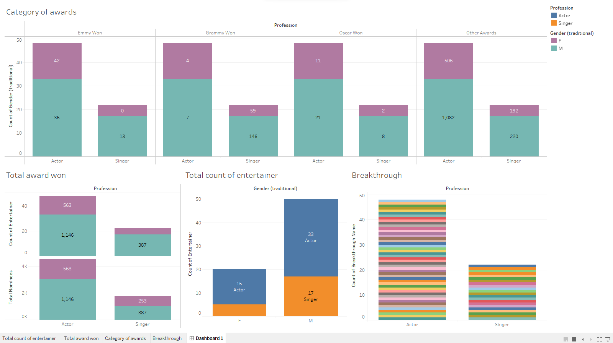

Slide 7
Explanation Insight
Actors have won more Emmy awards than singers, with male actors winning 42 and female actors winning 36.
Singers dominate the Grammy awards, with 146 awards for male singers and 59 for female singers.
Male actors have won the majority of Oscars (21), compared to 11 for female actors. Singers have won fewer Oscars.
Actors have won a significant number of other awards, with male actors winning 1,082 and female actors winning 506.
Total awards won: Actors - 1,146 (male: 563, female: 387), Singers - 387 (male: 253, female: 134).
Breakthroughs: Male actors have had more breakthroughs (33) than female actors (15). Male singers also have more breakthroughs (17) than female singers (8).
Gender distribution: More male entertainers have won awards than female entertainers.
Profession distribution: Actors, particularly male actors, have won more prestigious awards like Emmys and Oscars, while singers dominate the Grammy awards.

Slide 8
UNIFIED MENTOR INTERNSHIP
Details:
1 Month of duration- DATA ANALYST
Name: Hariprasath. S
Internship ID: UMIP3519
E-mail: hariprasathof26@gmail.com
Duration: February 1 to March 2

